Slide 1
Working Capital Management of Beximco & Square Pharmaceutical Ltd.
Afsana Mitu
Roll No: 18
Batch: 26

Slide 2
Introduction
Working capital is essential for daily business operations, allowing companies to make routine payments, cover unexpected costs, and purchase materials for production.
Working capital requirements vary by industry and among similar companies due to several factors. These include differences in collection and payment policies, the timing of asset purchases, the likelihood of writing off overdue accounts receivable, and any capital-raising efforts the company may be undertaking.
The primary purpose of working capital management is to make sure the company always maintains sufficient cash flow to meet its short-term operating costs and short-term debt obligations.

Slide 3
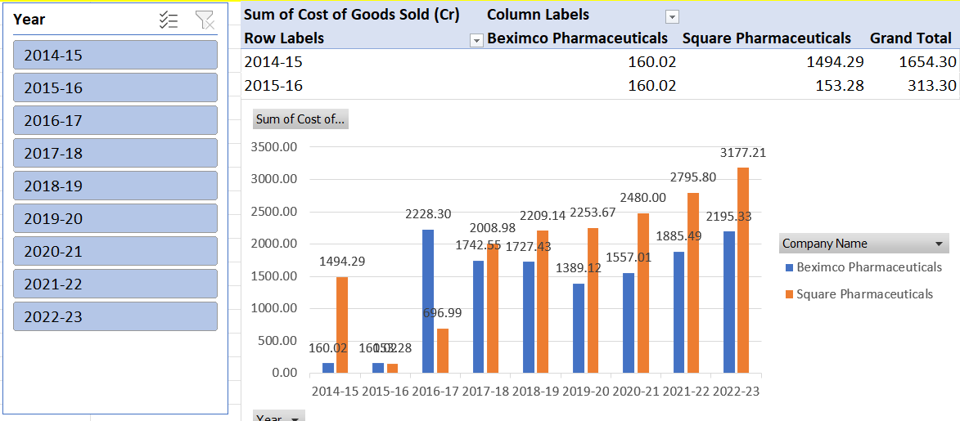
Inventory Turnover Ratio
The inventory turnover ratio is an efficiency ratio that shows how effectively inventory is managed by comparing cost of goods sold with average inventory for a period

Slide 4
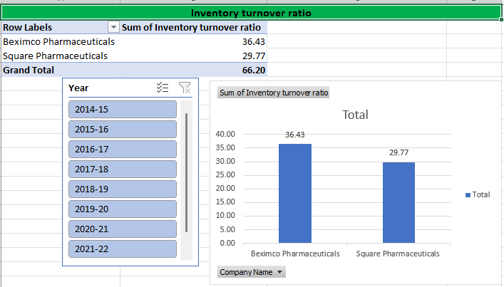
Inventory Turnover Ratio
The inventory turnover ratio comparison between Square Pharmaceuticals and Beximco Pharmaceuticals shows that Square has consistently outperformed Beximco in terms of inventory efficiency across most years from 2014-15 to 2022-23.

Slide 5
Thank You

